Slide 1
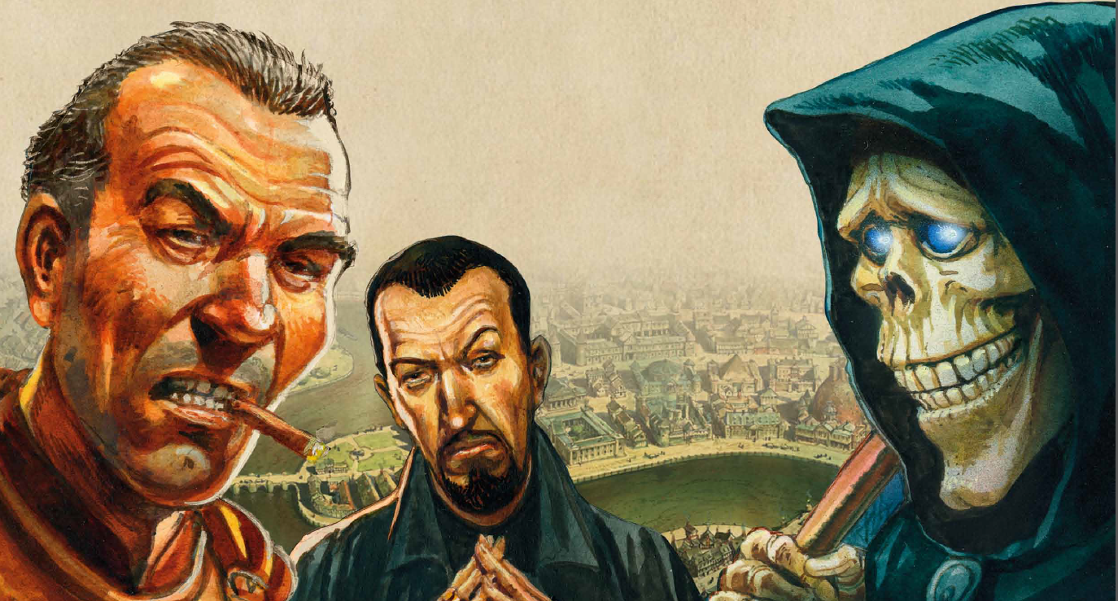
Software Architecture for Discworld: Ankh-Morpork
Team 23
Maniraho, Pascal
Pereira, Gustavo
Desai, Bhavik
Garro Matamoros, Jesus Esteban
Pizarro Ribera, Diego

